Slide 1
StatQuest: t-SNE Clearly Expalined!!!!

Slide 2
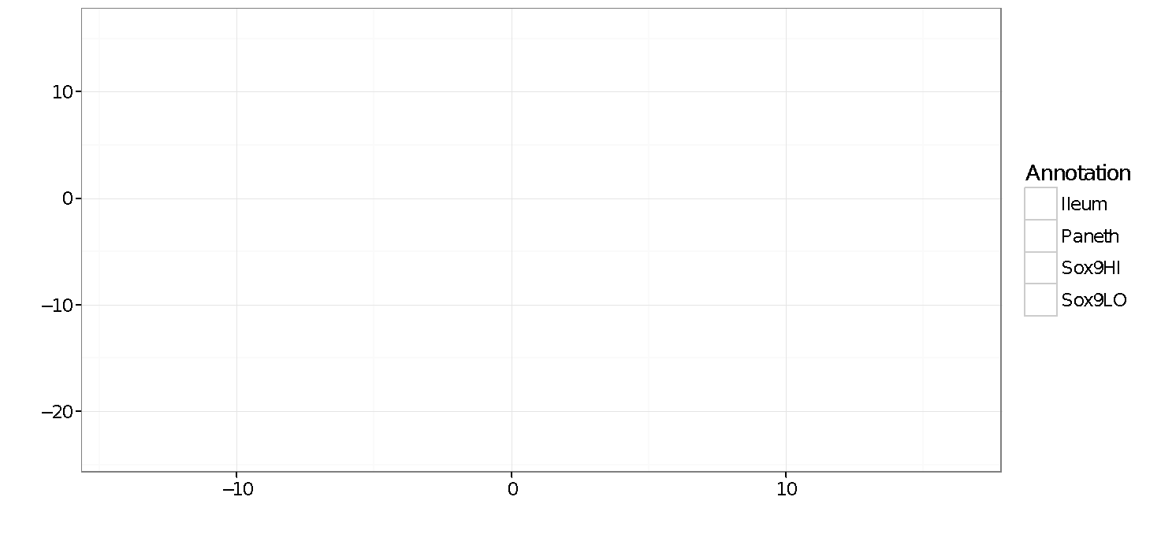

Slide 3
Here’s a basic 2-D scatter plot.

Slide 4
Here’s a basic 2-D scatter plot.
Let’s do a walk through of how t-SNE would transform this graph…

Slide 5
Here’s a basic 2-D scatter plot.
Let’s do a walk through of how t-SNE would transform this graph…
…into a flat, 1-D plot on a number line.

Slide 6
NOTE: If we just projected the data onto one of the axes, we’d just get a big mess that doesn’t preserve the original clustering.

Slide 7
Instead of two distinct clusters, we just see a mishmash.

Slide 8
Same here...

Slide 9
What t-SNE does is find a way to project data into a low dimensional space (in this case, the 1-D number line) so that the clustering in the high dimensional space (in this case, the 2-D scatter plot) is preserved.

Slide 10
So let’s step through the basic ideas of how t-SNE does this.

Slide 11
We’ll start start with the original scatter plot…

Slide 12
We’ll start start with the original scatter plot…
… then we’ll put the points on the number line in a random order.

Slide 13
From here on out, t-SNE moves these points, a little bit at a time, until it has clustered them.

Slide 14
Let’s figure out where to move this first point…

Slide 15
Let’s figure out where to move this first point…
Should it move a little to the left or a little to the right?

Slide 16
Because it is part of this cluster…

Slide 17
Because it is part of this cluster…
…it wants to move closer to these points.

Slide 18
But at the same time, these points…

Slide 19
But at the same time, these points… …are far away in the scatter plot…

Slide 20
But at the same time, these points… …are far away in the scatter plot…
…so they push back.

Slide 21
These points attract…

Slide 22
These points attract…
…while these points repel.

Slide 23
In this case, the attraction is strongest, so the point moves a little to the right.

Slide 24
In this case, the attraction is strongest, so the point moves a little to the right.

Slide 25
BAM!

Slide 26
Now let’s move this point a little bit…

Slide 27
These points attract…

Slide 28
These points attract…
…and this point repels a little bit.

Slide 29
So it moves a little to closer to the other orange points.

Slide 30
Double BAM!

Slide 31
At each step, a point on the line is attracted to points it is near in the scatter plot, and repelled by points it is far from…

Slide 32
At each step, a point on the line is attracted to points it is near in the scatter plot, and repelled by points it is far from…

Slide 33
At each step, a point on the line is attracted to points it is near in the scatter plot, and repelled by points it is far from…

Slide 34
At each step, a point on the line is attracted to points it is near in the scatter plot, and repelled by points it is far from…

Slide 35
At each step, a point on the line is attracted to points it is near in the scatter plot, and repelled by points it is far from…

Slide 36
At each step, a point on the line is attracted to points it is near in the scatter plot, and repelled by points it is far from…

Slide 37
At each step, a point on the line is attracted to points it is near in the scatter plot, and repelled by points it is far from…

Slide 38
At each step, a point on the line is attracted to points it is near in the scatter plot, and repelled by points it is far from…

Slide 39
At each step, a point on the line is attracted to points it is near in the scatter plot, and repelled by points it is far from…

Slide 40
At each step, a point on the line is attracted to points it is near in the scatter plot, and repelled by points it is far from…

Slide 41
At each step, a point on the line is attracted to points it is near in the scatter plot, and repelled by points it is far from…

Slide 42
At each step, a point on the line is attracted to points it is near in the scatter plot, and repelled by points it is far from…

Slide 43
At each step, a point on the line is attracted to points it is near in the scatter plot, and repelled by points it is far from…

Slide 44
At each step, a point on the line is attracted to points it is near in the scatter plot, and repelled by points it is far from…

Slide 45
At each step, a point on the line is attracted to points it is near in the scatter plot, and repelled by points it is far from…

Slide 46
At each step, a point on the line is attracted to points it is near in the scatter plot, and repelled by points it is far from…

Slide 47
At each step, a point on the line is attracted to points it is near in the scatter plot, and repelled by points it is far from…

Slide 48
At each step, a point on the line is attracted to points it is near in the scatter plot, and repelled by points it is far from…

Slide 49
At each step, a point on the line is attracted to points it is near in the scatter plot, and repelled by points it is far from…

Slide 50
At each step, a point on the line is attracted to points it is near in the scatter plot, and repelled by points it is far from…

Slide 51
At each step, a point on the line is attracted to points it is near in the scatter plot, and repelled by points it is far from…

Slide 52
At each step, a point on the line is attracted to points it is near in the scatter plot, and repelled by points it is far from…

Slide 53
At each step, a point on the line is attracted to points it is near in the scatter plot, and repelled by points it is far from…

Slide 54
At each step, a point on the line is attracted to points it is near in the scatter plot, and repelled by points it is far from…

Slide 55
At each step, a point on the line is attracted to points it is near in the scatter plot, and repelled by points it is far from…

Slide 56
At each step, a point on the line is attracted to points it is near in the scatter plot, and repelled by points it is far from…

Slide 57
At each step, a point on the line is attracted to points it is near in the scatter plot, and repelled by points it is far from…

Slide 58
At each step, a point on the line is attracted to points it is near in the scatter plot, and repelled by points it is far from…

Slide 59
At each step, a point on the line is attracted to points it is near in the scatter plot, and repelled by points it is far from…

Slide 60
At each step, a point on the line is attracted to points it is near in the scatter plot, and repelled by points it is far from…

Slide 61
At each step, a point on the line is attracted to points it is near in the scatter plot, and repelled by points it is far from…

Slide 62
At each step, a point on the line is attracted to points it is near in the scatter plot, and repelled by points it is far from…

Slide 63
Triple BAM!!!!!

Slide 64
Now that we’ve seen the what t-SNE tries to do, let’s dive into the nitty-gritty details of how it does what it does.

Slide 65
Step 1: Determine the “similarity” of all the points in the scatter plot.

Slide 66
Step 1: Determine the “similarity” of all the points in the scatter plot.
For this example, let’s focus on determining the similarities between this point and all of the other points.

Slide 67
First, measure the distance between two points…

Slide 68
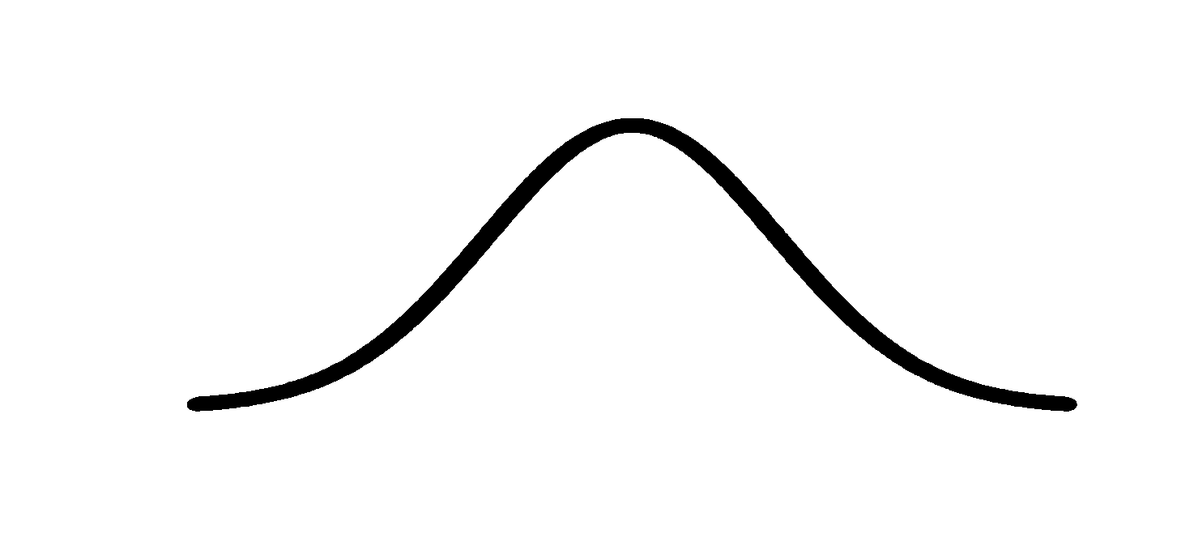
First, measure the distance between two points…
Then plot that distance on a normal curve that is centered on the point of interest…

Slide 69
First, measure the distance between two points…
Then plot that distance on a normal curve that is centered on the point of interest…
…lastly, draw a line from the point to the curve. The length of that line is the “unscaled similarity”.

Slide 70
First, measure the distance between two points…
Then plot that distance on a normal curve that is centered on the point of interest…
…lastly, draw a line from the point to the curve. The length of that line is the “unscaled similarity”.
(I made that terminology up, but it will make sense in just a bit!)

Slide 71
Now we calculate the “unscaled similarity” for this pair of points.

Slide 72
Now we calculate the “unscaled similarity” for this pair of points.

Slide 73
Now we calculate the “unscaled similarity” for this pair of points.

Slide 74
Now we calculate the “unscaled similarity” for this pair of points.

Slide 75
Now we calculate the “unscaled similarity” for this pair of points.

Slide 76
Now we calculate the “unscaled similarity” for this pair of points.

Slide 77
Now we calculate the “unscaled similarity” for this pair of points.
Etc. etc…

Slide 78
Using a normal distribution means that distant points have very low similarity values….

Slide 79
… and close points have high similarity values.

Slide 80
Ultimately, we measure the distances between all of the points and the point of interest…

Slide 81
Ultimately, we measure the distances between all of the points and the point of interest…
Plot them on the normal curve…

Slide 82
Ultimately, we measure the distances between all of the points and the point of interest…
Plot them on the normal curve…
…and then measure the distances from the points to the curve to get the unscaled similarity scores with respect to the point of interest.

Slide 83
The next step is to scale the unscaled similarities so that they add up to 1.

Slide 84
The next step is to scale the unscaled similarities so that they add up to 1.
Umm… Why do the similarity scores need to add up to 1?

Slide 85
It has to do with something I didn’t tell you earlier…

Slide 86
It has to do with something I didn’t tell you earlier…
…and to illustrate the concept, I need to add a cluster that is half as dense as the others.

Slide 87
The width of the normal curve depends on the density of data near the point of interest.

Slide 88
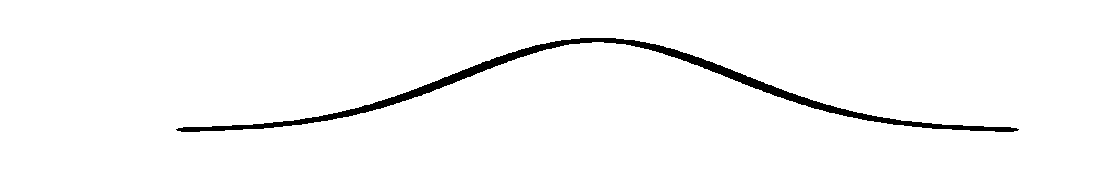
The width of the normal curve depends on the density of data near the point of interest.
Less dense regions have wider curves.

Slide 89
…so if these points… have half the density as these points…

Slide 90
…so if these points… have half the density as these points…

Slide 91
…so if these points… have half the density as these points…
…and this curve…
is half as wide as
this curve…

Slide 92
…so if these points… have half the density as these points…
…and this curve…
is half as wide as
this curve…

Slide 93
…so if these points… have half the density as these points…
…and this curve…
is half as wide as
this curve…
…then scaling the similarity scores will make them the same for both clusters.

Slide 94
Here’s an example…

Slide 95
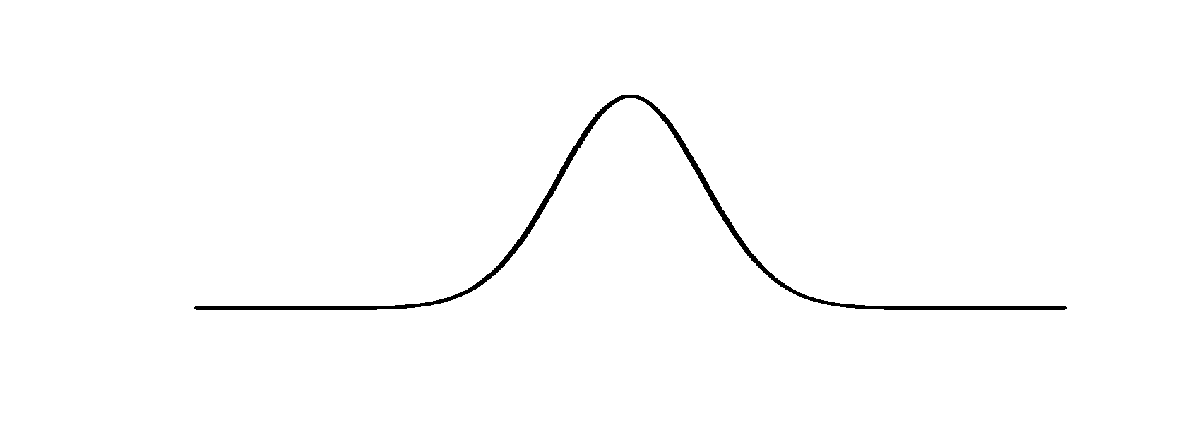
Here’s an example…
This curve has a standard deviation = 1.

Slide 96
Here’s an example…
= 0.24
This curve has a standard deviation = 1.
The “unscaled” similarity values
= 0.05

Slide 97
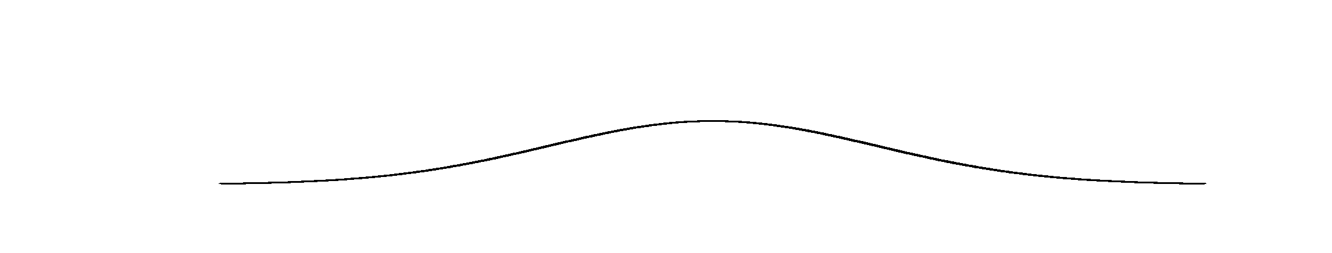
Here’s an example…
= 0.24
This curve has a standard deviation = 1.
The “unscaled” similarity values
= 0.05
This curve has a standard deviation = 2.

Slide 98
Here’s an example…
= 0.24
This curve has a standard deviation = 1.
The “unscaled” similarity values
= 0.05
These points are twice as far from the middle.
This curve has a standard deviation = 2.

Slide 99
Here’s an example…
= 0.24
This curve has a standard deviation = 1.
The “unscaled” similarity values
= 0.05
These points are twice as far from the middle.
The “unscaled” similarity values are half of the other ones.
This curve has a standard deviation = 2.
= 0.12
= 0.024

Slide 100
To scale the similarity scores so they sum to 1:
= 0.24
Score
= Scaled Score
Sum of all scores
= 0.05
= 0.12
= 0.024

Slide 101
To scale the similarity scores so they sum to 1:
0.24
= 0.82
= 0.24
0.24 + 0.05
Score
0.05
= Scaled Score
= 0.18
Sum of all scores
0.24 + 0.05
= 0.05
= 0.12
= 0.024

Slide 102
To scale the similarity scores so they sum to 1:
0.24
= 0.82
= 0.24
0.24 + 0.05
Score
0.05
= Scaled Score
= 0.18
Sum of all scores
0.24 + 0.05
= 0.05
0.12
= 0.82
0.12 + 0.024
= 0.12
= 0.024
0.024
= 0.18
0.12 + 0.024

Slide 103
To scale the similarity scores so they sum to 1:
0.24
= 0.82
= 0.24
0.24 + 0.05
Score
0.05
= Scaled Score
= 0.18
Sum of all scores
0.24 + 0.05
= 0.05
These are the same as these!
0.12
= 0.82
0.12 + 0.024
= 0.12
= 0.024
0.024
= 0.18
0.12 + 0.024

Slide 104
That implies that the scaled similarity scores for this relatively tight cluster…
0.24
= 0.82
0.24 + 0.05
0.05
= 0.18
0.24 + 0.05
0.12
= 0.82
0.12 + 0.024
0.024
= 0.18
0.12 + 0.024

Slide 105
That implies that the scaled similarity scores for this relatively tight cluster…
0.24
= 0.82
0.24 + 0.05
0.05
= 0.18
…are the same for this relatively loose cluster!
0.24 + 0.05
0.12
= 0.82
0.12 + 0.024
0.024
= 0.18
0.12 + 0.024

Slide 106
The reality is a little more complicated, but only slightly.

Slide 107
The reality is a little more complicated, but only slightly.
t-SNE has a “perplexity” parameter equal to the expected density, and that comes into play, but these clusters are still more “similar” than you might expect.

Slide 108
Now back to the original scatter plot…

Slide 109
We’ve calculated similarity scores for this point.

Slide 110
Now we do it for this point…

Slide 111
Now we do it for this point…
…and we do it for all the points.

Slide 112
One last thing and the scatter plot will be all set with similarity scores!!!

Slide 113
Because the width of the distribution is based on the density of the surrounding data points, the similarity score to this node…

Slide 114
…might not be the same as the similarity to this node.

Slide 115
So t-SNE just averages the two similarity scores from the two directions…

Slide 116
So t-SNE just averages the two similarity scores from the two directions…
No big deal!

Slide 117
= High similarity
= Low similarity
Ultimately, you end up with a matrix of similarity scores.

Slide 118
= High similarity
= Low similarity

Slide 119
= High similarity
= Low similarity
Hooray!!! We’re done doing calculating similarity scores for the scatter plot!

Slide 120
Now we randomly project the data onto the number line…

Slide 121
Now we randomly project the data onto the number line…
… and calculate similarity scores for the points on the number line.

Slide 122
Just like before, that means picking a point…

Slide 123
Just like before, that means picking a point…
…measuring a distance…

Slide 124
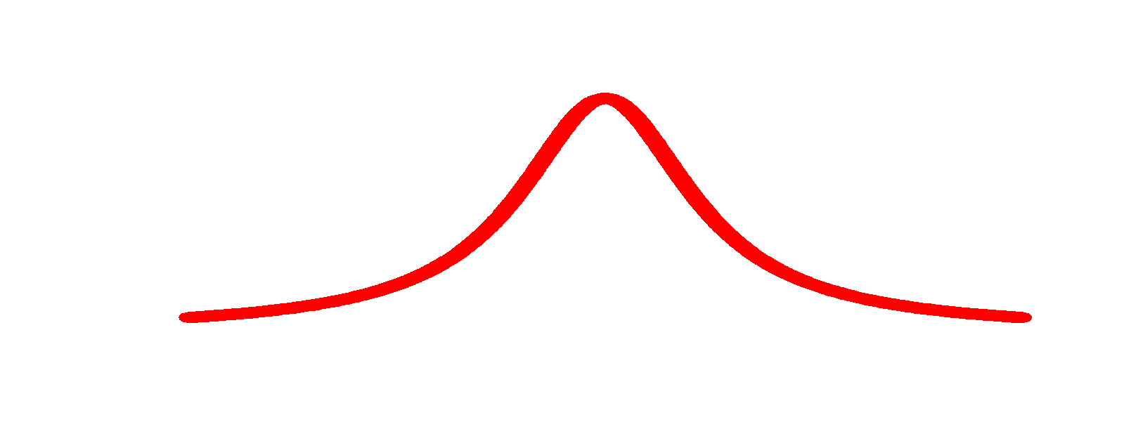
…and lastly, drawing a line from the point to a curve. However, this time we’re using a “t-distribution”.
Just like before, that means picking a point…
…measuring a distance…

Slide 125
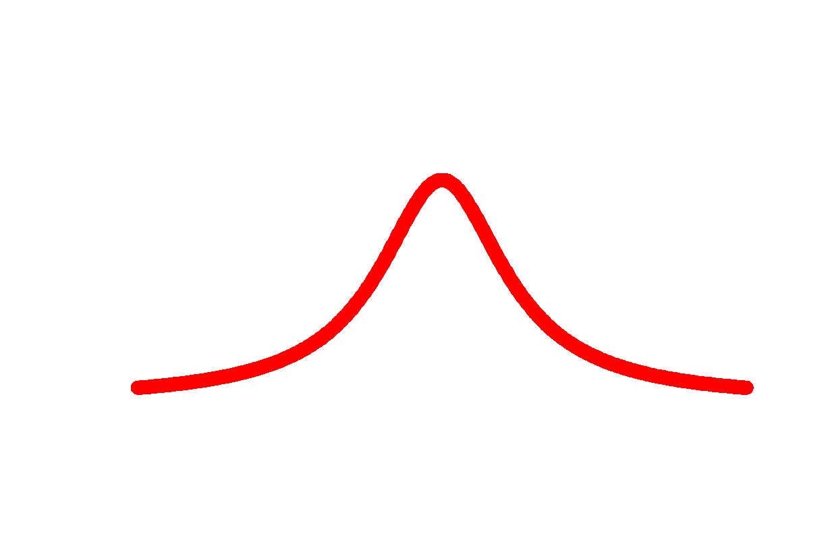
A “t-distribution”…

Slide 126

A “t-distribution”…
…is a lot like a normal distribution

Slide 127
A “t-distribution”…
…is a lot like a normal distribution…
…except the “t” isn’t as tall in the middle…

Slide 128
A “t-distribution”…
…is a lot like a normal distribution…
…except the “t” isn’t as tall in the middle…
… and the tails are taller on the ends.

Slide 129
A “t-distribution”…
…is a lot like a normal distribution…
…except the “t” isn’t as tall in the middle…
… and the tails are taller on the ends.
The “t-distribution” is the “t” in t-SNE.

Slide 130
A “t-distribution”…
…is a lot like a normal distribution…
…except the “t” isn’t as tall in the middle…
… and the tails are taller on the ends.
The “t-distribution” is the “t” in t-SNE.
We’ll talk about why the t-distribution is used in a bit…

Slide 131
So, using a t-distribution, we calculate “unscaled” similarity scores for all the points and then scale them like before.

Slide 132
= High similarity
= Low similarity
Like before, we end up with a matrix of similarity scores, but this matrix is a mess…

Slide 133
= High similarity
= High similarity
= Low similarity
= Low similarity
Like before, we end up with a matrix of similarity scores, but this matrix is a mess…
…compared to the original matrix.

Slide 134
The goal of moving this point is…

Slide 135
The goal of moving this point is…
we want to make this row…

Slide 136
The goal of moving this point is…
we want to make this row…
look like this row.

Slide 137
t-SNE moves the points a little bit at a time, and each step it chooses a direction that makes the matrix on the left more like the matrix on the right.

Slide 138
t-SNE moves the points a little bit at a time, and each step it chooses a direction that makes the matrix on the left more like the matrix on the right.

Slide 139
t-SNE moves the points a little bit at a time, and each step it chooses a direction that makes the matrix on the left more like the matrix on the right.
It uses small steps, because it’s a little bit like a chess game and can’t be solved all at once. Instead, it goes one move at at time.

Slide 140
BAM!!!

Slide 141
Now to finally tell you why the “t-distribution” is used…

Slide 142
…originally, the “SNE” algorithm just used a normal distribution throughout and the clusters clumped up in the middle and were harder to see.

Slide 143
The t-distribution forces some space between the points.

Slide 144
Triple Bam!!!

Slide 145
The End!!!

